Slide 1

Diabetes Prediction With Deep Learning
ARIGELA THRINESH
REG NO : 211521243020
COLLEGE : PANIMALAR INSTITUTE OF TECHNOLOGY
MAIL : thrinesharigela@gmail.com
3/21/2024 Annual Review
1

Slide 2
PROJECT TITLE :
Diabetes Prediction With Deep Learning
3/21/2024 Annual Review
2

Slide 3
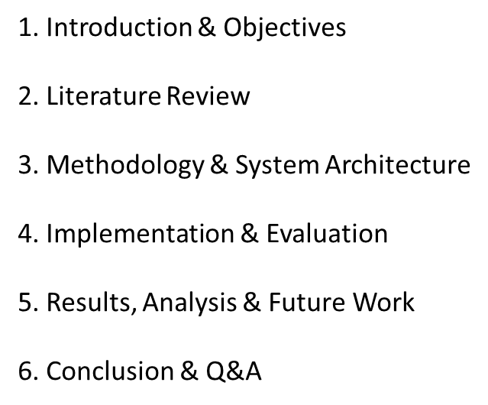

AGENDA
3/21/2024 Annual Review
3

Slide 4

PROBLEM
STATEMENT :
A chronic illness that affects millions of individuals globally is
diabetes. Diabetes must be identified and treated early to reduce
complications and enhance the quality of life for those who have it.
Our goal in this research is to create a deep learning model that, given a
variety of parameters including age, blood pressure, BMI, and glucose levels,
can reliably predict when diabetes will manifest .A dataset of patient data
should be processed by the model, which should then be able to
categorize them as either having diabetes or not. getting a tool that can help
medical practitioners identify people who are at risk of getting diabetes is the
ultimate goal, as it will enable early intervention and better
patient outcomes.
3/21/2024 Annual Review
4

Slide 5

PROJECT OVERVIEW
obviously! An outline of a deep learning project for diabetes prediction is provided below: Goal: Create a precise model for identifying diabetes early on.
Dataset: Make use of the PIMA dataset, which contains clinical diabetes data.
Methodology: Generate images from numerical features
The three classification strategies : chosen fusion features with SVM,deep feature
fusion with SVM, and CNN models.
Results: Shows resilience in the early diagnosing process.
3/21/2024 Annual Review
5

Slide 6

WHO ARE THE END USERS?
This diabetes prediction project may have the following final users: Medical professionals and clinicians: Physicians, nurses, and other healthcare workers
who can help with early diagnosis by using the model. To identify patients who are at risk of diabetes, they can include the prediction method
into their clinical practice.
Individuals and Patients: Those who wish to determine their chance of contracting diabetes.
The model might be included in online platforms or health apps where users can enter
pertinent information for individualized risk assessments.
Hospitals and healthcare facilities: These businesses can integrate the concept into their
current systems . Effective resource allocation, screening prioritization,
and patient triaging can all be facilitated by it.
3/21/2024 Annual Review
6

Slide 7
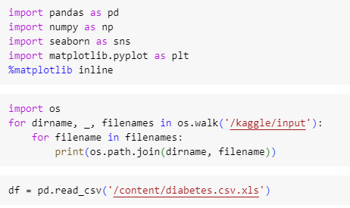
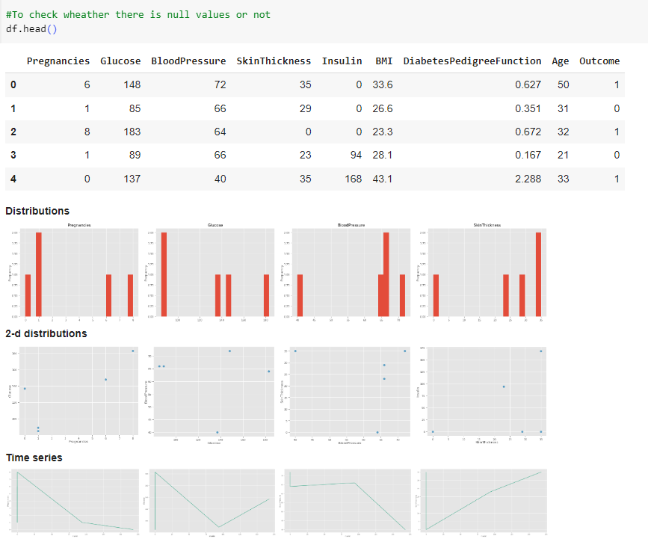

DEVELOPING A MODEL
3/21/2024 Annual Review
7

Slide 8
YOUR SOLUTION AND ITS VALUE PROPOSITION
Numeric-to-Image Conversion:
Solution: Convert numerical clinical data (such as the PIMA dataset) into images based on feature importance.
TWO Approaches:
Direct CNN Classification: Feed diabetes images into CNN models.
Deep Feature Fusion: Combine deep features from models and classify using support vector machines (SVM).
Deep Learning Algorithms for HRV Signals:
Solution: Analyse heart rate variability (HRV) signals using deep learning architectures like CNN and LSTM.
Value Proposition:
Feature Extraction: Deep learning eliminates the need for manual feature selection and extraction.
Pipeline with Data Augmentation and CNN:
Solution: Use a pipeline with variational autoencoders (VAE) for data augmentation,
sparse autoencoders (SAE) for feature augmentation, and a CNN for classification.
Value Proposition:
Enhanced Data: Augment data to improve model performance.
Automated Feature Learning: Deep learning techniques automatically learn relevant features from the data.
3/21/2024 Annual Review
7

Slide 9

THE
WOW
IN
YOUR
SOLUTION
Early Detection and Intervention:
By predicting diabetes risk, patients can adopt preventive measures,
manage their lifestyle, and seek medical advice proactively.
Real-Time Monitoring:
Patients can receive continuous updates on their health status,
enabling better disease management.
High Accuracy:
Achieving accuracy levels of 90–98% is impressive.
Holistic Approach:
This holistic approach ensures comprehensive diabetes
prediction and management.
Contributing to Public Health:
These solutions contribute to public health by addressing a
widespread and critical health issue.
3/21/2024 Annual Review
8

Slide 10
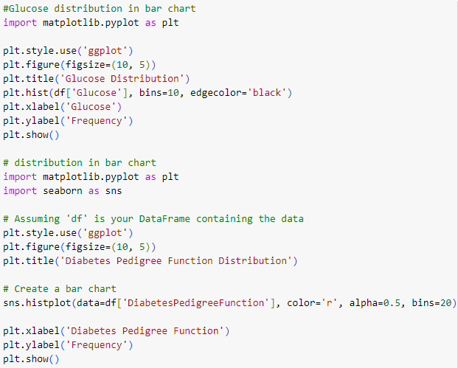
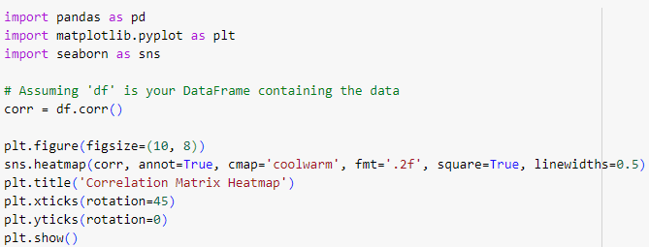
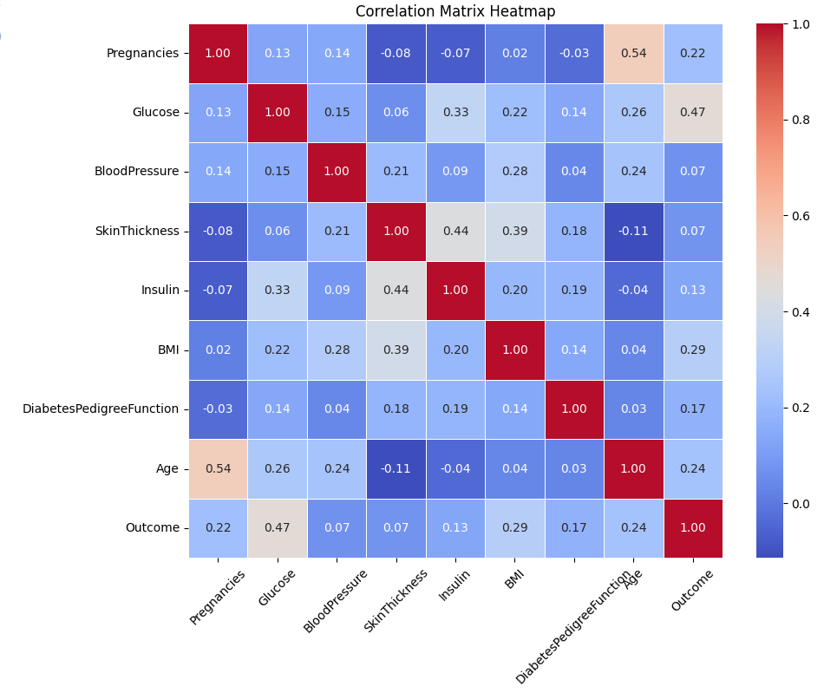
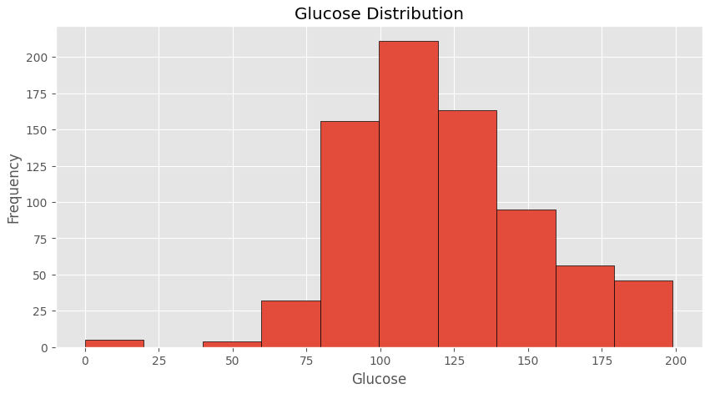
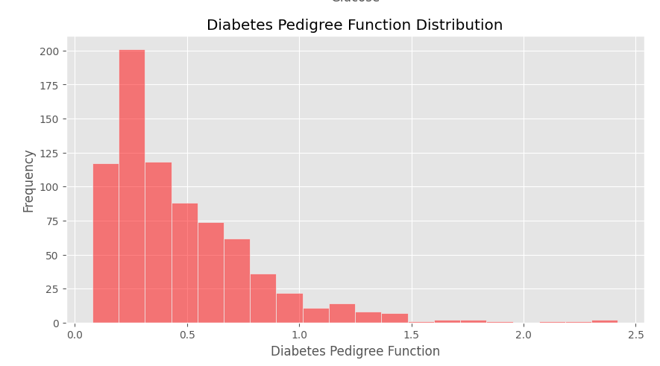
MODELLING
3/21/2024 Annual Review
9

Slide 11
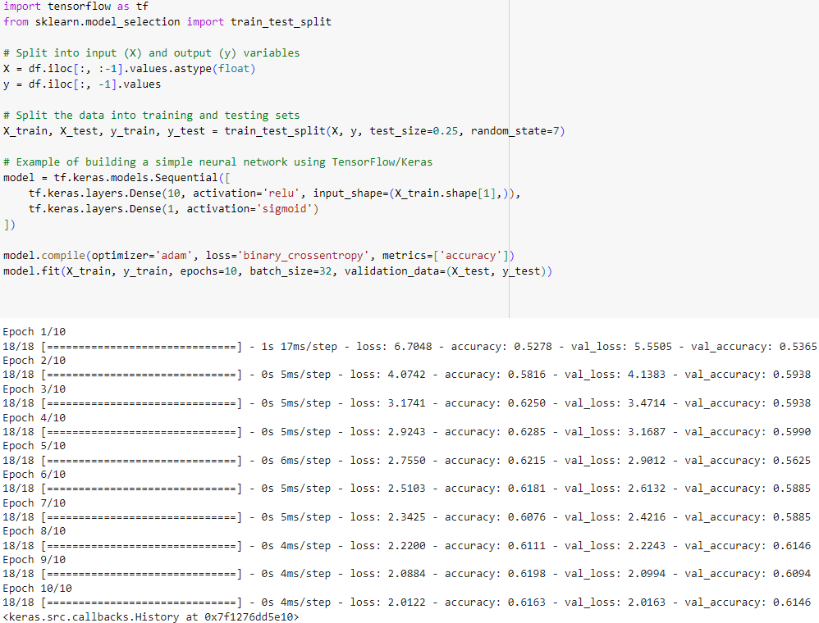
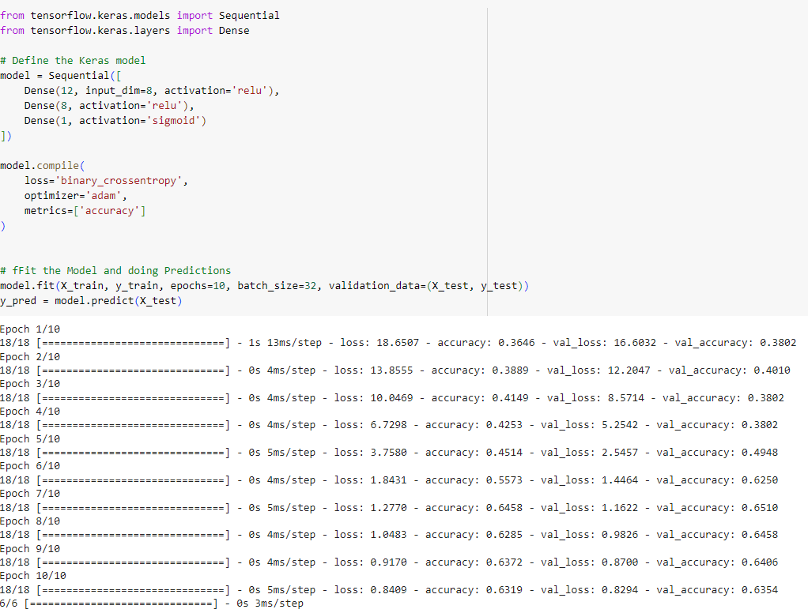
RESULT :
In summary, deep learning empowers early intervention, accurate classification, and transformative healthcare outcomes.
Transforming clinical data into images allows robust representation and early detection. Deep learning models, such as CNNs and SVMs,
excel in classifying diabetes cases based on these images.
Deep learning algorithms applied to heart rate variability signals provide accurate predictions without relying on traditional methods.
3/21/2024 Annual Review
10

